Slide 1
Project – R
NY Bus Break Downs and Delays
By:
Roli Srivastava
Aug 8, 2018
Notes:
Our presentation will look into New York’s Bus Break Downs and delays.

Slide 2


Slide 3
Contents
Overview of the project
Purpose of the study
Methodologies used
Data Description
Insights
References
Notes:
In this presentation, we will start off with the overview of this project, discuss about purpose of this study, talk about the methodologies used, and the insights of what we have learned from this study.

Slide 4
Overview of the project
Seeing lot of bus breakdown these days in NY, we wanted to study the bus breakdown and delay through authentic source and wanted to know the reasons for these delays.
In our study, we wanted to help find delay trends over the years and suggest factors to help in minimizing the problem of delay.
There are 235759 records of 21 attributes. 2 records were dropped due to incomplete information.
The Dataset contained missing values and was cleaned using the R programming language.
Notes:
Looking at what had happened to bus breakdown these days, we would like to study and understand the reasons behind those breakdowns and delays. By make full use of the data we obtained, we want to find the delay trends throughout the years as well as determine the factors in minimizing problem of delay. In the data set, we have 235759 records of 21 attributes. Unfortunately, we need to drop 2 records as result of incomplete information. In the process of cleaning up this huge data set, we utilized R programming language to ensure result to be as accurate as possible.

Slide 5
Purpose of the study
To analyze the several factors such as Reasons, Boro causing these delays
An overview of the trend over the years and suggests factors that can help the minimize this delay
To see if School and Parents are notified and OPT’s are alerted for the delays.
Can predict if delay will be higher or lower, when making a choice. E.g.: using a model based on Boro
Notes:
The sole purpose on conducting this study is to analyze the factors for instance, reasons and districts that caused these delays. We will also look into the time trend which consists of annual data and suggest factors that can help minimize the delays. In this study, we are interested to know if school and parents are notified of the delays. And if the delays will be transmitted to Office of Student Transportation as an alert. We would also like to predict if the delay will be higher or lower contingence of the choice we made.

Slide 6
Methodologies used
Descriptive statistics
Correlational studies
Hypothesis Testing
Regression
Tools used: R
Notes:
In this presentation, we took advantage of descriptive statistic in better present our findings. As this study includes multiple coefficients, we used Correlation Matrix to determine the variables that has strong relationship with the variable we used to measure delays. Hypothesis is applied to ensure the statistical significant of our results. Regression is adopted to predict the delay time based on run type.

Slide 7

Data Description

Slide 8
Field Name | Description
School_Year String | Indicates the school year the record refers to. The DOE school year starts in September every year.
Busbreakdown_ID Number | Unique ID each record
Run_Type String | General Ed AM Run General Ed PM Run General Ed Field Trip Special Ed AM Run Special Ed PM Run Special Ed Field Trip Pre-K/EI
Bus_No String | The bus number is assigned by the bus vendor. The numbers are not unique identifiers and may be repeated across vendors.
Route_Number String | indicates stop-to-school service

Slide 9
Field Name | Description
Reason String | Accident Delayed by School Flat Tire Heavy Traffic Mechanical Problem Other Problem Run Weather Conditions Won't Start
Schools_Serviced String | OPT Codes of all transportation sites on the route. If there is more than one site, each site code will be separated by a comma.
Occurred_On datetime | Time/date the incident occurred
Created_On datetime | Time/date the record was created in the OPT Breakdown and Delay system.

Slide 10
Field Name | Description
Boro String | Borough, county or state in which the delay occurred
Company_Name String | Bus vendor name of the reporting bus vendor.
How_Long_Delayed String | Length of delay.
Number_Of_Students_On_The_Bus Number | Number of students on the bus at the time of the incident
Has_Contractor_Notified_Schools NString | Indicator status
Has_Contractor_Notified_Parents String | Indicator status
Have_You_Alerted_OPT String | Indicator status.
Informed_On datetime | Date on which the school, parents or OPT was notified
Incident_Number String | Incident number
Last_Updated_On datetime | Time/date the record was last updated
Breakdown_or_Running_Late String | Indicator status
School_Age_or_PreK String | Indicator of whether the route serves the school-age or Pre-K/EI population.

Slide 11
Insights

Slide 12
Descriptive
summary | values
alpha | 0.05
Standard deviation | 17.58
Sample size n | 235759
sample average/mean | 20.69
Confidence Interval | 95%
Error | 0.07
Lower | 20.62
Upper | 20.76

Slide 13
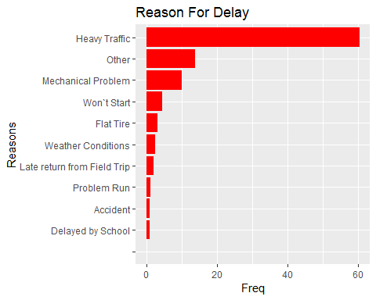
The main reasons for the delay were found to be Heavy Traffic, Mechanical problem, bus won’t start, flat tire and weather conditions. These are the top 5 main reasons for the delay.

Slide 14
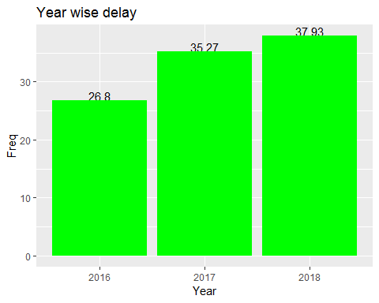
The year wise delay observed is 37.93% in year 2018, 35.27% in year 2017 and 26.8% in year 2016.
There is a trend of gradual increase in the delay year wise can be very easily observed.

Slide 15
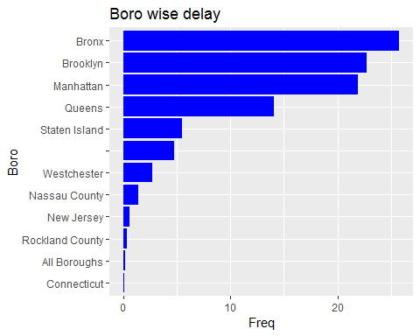
The county wise delay is found through the analysis. Bronx, Brooklyn, Manhattan, Queens, Staten Island are the top 5 Boros where highest frequency of delay can be seen

Slide 16
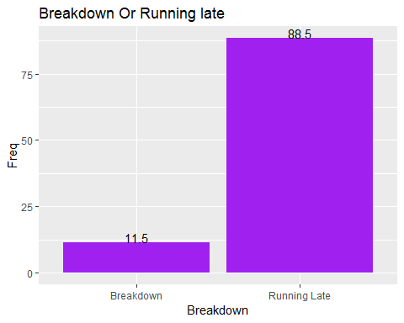
The delay is mostly because of the breakdown or bus running late. It is observed that 88.5% times delay is due to bus running late and other 11.5% times is due to bus breakdown.

Slide 17
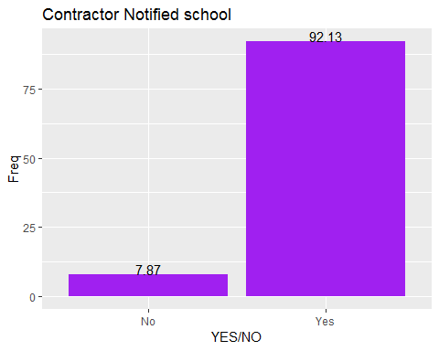
It is being observed that 92.13% times contractor notified the school about the bus breakdown or the running late and 7.87% contractor failed to notify the school.

Slide 18
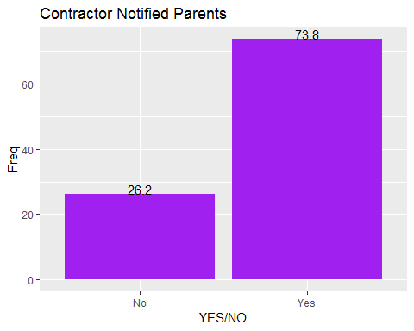
It is being observed that 73.8% times contractor notified the Parents about the bus breakdown or the running late and 26.2% contractor failed to notify the Parents.

Slide 19
It is being observed that 70.62% times OPT have been alerted about the bus breakdown or the running late and 29.38% OPT was not alerted.

Slide 20
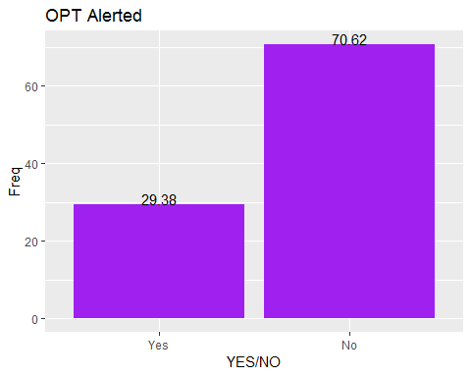
It is being observed that 70.62% times OPT have been alerted about the bus breakdown or the running late and 29.38% OPT was not alerted.

Slide 21
Correlational matrix studies:
Positive and strong correlation between School_Year and the total minutes of delay is being observed.
0.8546084

Slide 22
Hypothesis analysis
the average length of delays (minutes)
## mean = 20.6923 ; sd = 17.5817 ; n = 235758 ## Standard error = 0.0362 ## 95 % Confidence interval = ( 20.6213 , 20.7633 )
We see that our average length of delay is 20.6923 mins which is in alignment with our descriptive study of delay which was also 20.69.

Slide 23
Hypothesis cont.
we want to know , if delay time is impacted by the (Breakdown, RunningLate).
## H0: mu_Breakdown - mu_Running Late = 0 ## HA: mu_Breakdown - mu_Running Late != 0 ## Standard error = 0.037 ## Test statistic: Z = -627.306 ## p-value = 0
our p-value 0 < 0.05 so we reject our null hypothesis meaning there is enough evidence in the data to say there is some difference in the average time delayed by buses whose running were considered breakdown and those running late.

Slide 24
Hypothesis analysis
we want to know any significant relationship between delay time and reasons for delay, so we conducted ANOVA on Reason for How_Long_Delayed
## ANOVA ## H_0: All means are equal. ## H_A: At least one mean is different. ## Analysis of Variance Table ## Response: y ## Df Sum Sq Mean Sq F value Pr(>F) ## x 10 3414356 341436 1158.8 < 2.2e-16 ## Residuals 235747 69461880 295
We found that the F value high is 1158.8, and p-value is very low too.
we accept the alternative hypothesis H1 that there is a significant relationship between Delay time and Reason for delay.

Slide 25
Regression analysis
We tried to find a linear model to predict the delay time based on Breakdown_or_Running_Late.
We came up with model to predict the delay based on this:
DELAY_IN_MINS = 0.01162 + 23.36871 * Breakdown_or_Running_Late
m1 <- lm(How_Long_Delayed ~ Breakdown_or_Running_Late, data = busData) ## Estimate Std. Error t value Pr(>|t|) ## (Intercept) 0.01162 0.09669 0.12 0.904 ## Breakdown_or_Running_LateRunning Late 23.36868 0.10278 227.36 <2e-16
## Residual standard error: 15.92 on 235756 degrees of freedom ## Multiple R-squared: 0.1798, Adjusted R-squared: 0.1798 ## F-statistic: 5.169e+04 on 1 and 235756 DF, p-value: < 2.2e-16
:

Slide 26
Regression cont.
## Y = how long delayed , X = Breakdown_or_Running_Late ## Y = 0.01162 + 23.36871 * X ## So Breakdown is 0 and running late is 1 ## for breakdown line is Y = 0.01162 for running late line is Y = 0.01162 + 23.36871 * 1 = 23.38033

Slide 27
Regression cont.
We tried to find a linear model to predict the delay time based on Reason for the delay
We tried to come up with model to predict the delay based on reason for the delay:
## Residual standard error: 17.17 on 235747 degrees of freedom ## Multiple R-squared: 0.04685, Adjusted R-squared: 0.04681 ## F-statistic: 1159 on 10 and 235747 DF, p-value: < 2.2e-16
But we can see that R- squared value is low 0.04685 so this model cannot be of good use.

Slide 28
Regression cont.
We tried to find a multiple regression model to predict the delay time based on Reason, Boro for the delay
We tried to come up with model to predict the delay based on reason , boro for the delay:
## Residual standard error: 16.2 on 235125 degrees of freedom ## Multiple R-squared: 0.0779, Adjusted R-squared: 0.07781 ## F-statistic: 945.8 on 21 and 235125 DF, p-value: < 2.2e-16
But we can see that R- squared value is low 0.0779 so this model cannot be of good use.

Slide 29
Regression cont.
We tried to find a multiple regression model to predict the delay time based on Reason, Breakdown_or_Running_Late, Boro, Bus_Company_Name, School_Year for the delay
We tried to come up with model to predict the delay based on reason , boro for the delay:
lm(formula = How_Long_Delayed ~ Reason + Breakdown_or_Running_Late + Boro + Bus_Company_Name, data = delayData)
## Residual standard error: 14.89 on 235679 degrees of freedom ## Multiple R-squared: 0.283, Adjusted R-squared: 0.2828 ## F-statistic: 1193 on 78 and 235679 DF, p-value: < 2.2e-16
But we can see by far this is the best we got R- squared value is low 0.283 so this model we can use

Slide 30
Conclusion

Slide 31
Conclusion
We found that the average delay time was the 20.69 .
The main reasons for the delay were found to be Heavy Traffic, Mechanical. problem, bus won’t start, flat tire and weather conditions.
There is a trend of gradual increase in the delay year wise.
Bronx, Brooklyn, Manhattan, Queens, Staten Island boro seeing most delays.
It is observed that 88.5% times delay is due to bus running late .
7.87% contractor failed to notify the school.
26.2% contractor failed to notify the Parents.
29.38% OPT was not alerted.

Slide 32
Conclusion
Positive and strong correlation between School_Year and the total minutes of delay .
DELAY_IN_MINS = 0.01162 + 23.36871 * RUN_TYPE
No good model ,but we saw model to predict the delay based on reason , boro,best R- squared value with low 0.283 but reusable model.

Slide 33
References
https://www.statmethods.net/graphs
https://stat.utexas.edu/videos/r/statistical-inference
https://data.cityofnewyork.us/resource/fbkk-fqs7.json

Slide 34

Thank you!

